Slide 1

ASCDINATD WEBINAR
FINAL FEDERAL ACQUISITION REGULATION RULE REGARDING THE REPORTING OF NONCONFORMING ITEMS TO THE GOVERNMENT-INDUSTRY DATA EXCHANGE PROGRAM (GIDEP)
DECEMBER 9, 2019
1

Slide 2
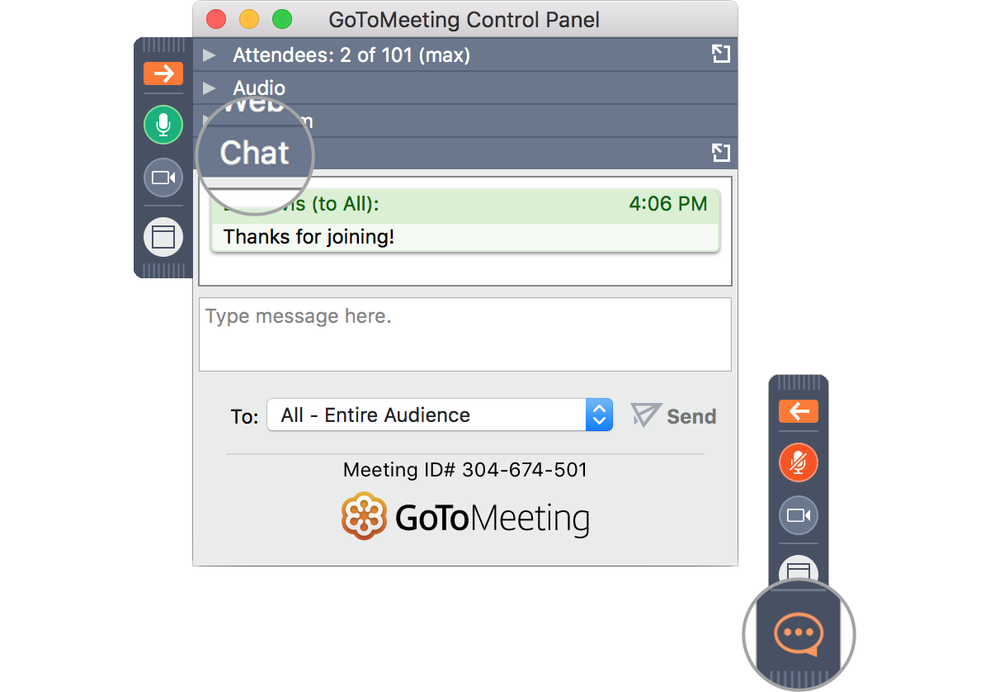

Questions?
Organizer

Slide 3








PRESENTERS
Neil Vill
President & CEO – World Data Products, Inc.
Chairman, ASCDI Anti-Counterfeit Committee
Keith Gregory
Attorney & Partner – Snell & Wilmer LLP
3

Slide 4
AGENDA
WHAT’S NEW AND WHAT’S CHANGED
BACKGROUND
DEFINITIONS AND EXPLANATIONS
HISTORY OF THIS FEDERAL ACQUISITION REGULATION (FAR) RULE
KEY ELEMENTS AND REQUIREMENTS
BEST PRACTICES
HOW TO REPORT TO GIDEP
POTENTIAL LIABILITY ISSUES
HOW TO DEFEND YOUR COMPANY IF YOU ARE THE OBJECT OF A REPORT
AND TURN THIS INTO A MARKETING OPPORTUNITY FOR YOUR COMPANY
Q&A
4

Slide 5
BACKGROUND
SOME KNOWLEDGE OF U.S. FEDERAL GOVERNMENT CONTRACTING REGULATIONS IS ASSUMED IN THIS PRESENTATION
NEIL WILL REVIEW THE NEW REQUIREMENTS; KEITH WILL RECOMMEND BEST PRACTICES
COMPLETE TEXT OF THE FEDERAL REGISTER NOTICE CAN BE FOUND AT https://www.federalregister.gov/documents/2019/11/22/2019-24960/federal-acquisition-regulation-reporting-of-nonconforming-items-to-the-government-industry-data
5

Slide 6
Neil Vill
President & CEO – World Data Products, Inc.
Chairman, ASCDI Anti-Counterfeit Committee
6

Slide 7
KEY DEFINITIONS (1)
GIDEP – Government-Industry Data Exchange Program
GIDEP is a cooperative activity between government and industry participants seeking to reduce or eliminate expenditures of resources by sharing technical information
Focused on United States & Canada
FAR – Federal Acquisition Regulation
COUNTERFEIT ITEM:
An unlawful or unauthorized reproduction, substitution, or alteration that has been knowingly mismarked, misidentified, or otherwise misrepresented to be an authentic, unmodified item from the original manufacturer, or a source with the express written authority of the original manufacturer or current design activity, including an authorized aftermarket manufacturer. Unlawful or unauthorized substitution includes used items represented as new, or the false identification of grade, serial number, lot number, date code, or performance characteristics.
7

Slide 8
KEY DEFINITIONS (2)
CRITICAL ITEM:
An item, the failure of which is likely to result in hazardous or unsafe conditions for individuals using, maintaining, or depending upon the item; or is likely to prevent performance of a vital agency mission
SUSPECT COUNTERFEIT ITEM:
An item for which credible evidence (including but not limited to, visual inspection or testing) provides reasonable doubt that the item is authentic.
8

Slide 9
HISTORY OF THIS FAR RULE
First proposed in Federal Register in June 2014 (FAR Case 2013-002)
Intended to partially implement Section 818 of the National Defense Authorization Act (NDAA) for Fiscal Year (FY) 2012 (reporting of non-conforming electronic parts sold to Dept. of Defense)
FAR Council expanded the scope beyond DoD and beyond electronic parts
Called for contractors to report to GIDEP directly instead of through agencies
Years of deliberations, hearings, comments
Final rule adopted November 2019
Rule becomes effective on December 23, 2019
More limited in scope than initial proposal
Some uncertainties remain
9

Slide 10
KEY ELEMENTS & REQUIREMENTS (1)
In the past, contractor participation has been largely voluntary
Why? “Timely GIDEP reporting and screening allows all contractors to promptly investigate and remove suspect parts from the supply chain and to ensure that suspect parts are not installed in equipment which would result in experiencing high failure rates”
Contractors and Subcontractors required to report to GIDEP certain counterfeit or suspect counterfeit parts and certain major or critical nonconformances (focused on complex items with critical applications where the failure of the item could injure personnel or jeopardize a vital agency mission)
10

Slide 11
KEY ELEMENTS & REQUIREMENTS (2)
APPLICABILITY:
  Contracts including the clause at FAR 52.246-11
  Items that are subject to higher-level quality standards (e.g., ISO 9001, AS 5553)
  Items determined to be “critical”
  Services provided in conjunction with the above categories
  Contractors AND subcontractors

Slide 12
KEY ELEMENTS & REQUIREMENTS (3)
EXCEPTIONS:
  The new rule does NOT apply to contracts and subcontracts for the acquisition of commercial items, including commercially available off-the-shelf (COTS) items
    For ASCDI members, a CRUCIAL exception to the above statement is electronic parts or systems sold to the DoD where the acquisition exceeds the simplified acquisition threshold; these must be reported
  Certain medical devices
  Foreign corporations without offices in U.S.
  Items under “on-going criminal investigation”
  Items confirmed by the supplier not to have been sold to more than one customer

Slide 13
KEY ELEMENTS & REQUIREMENTS (4)
SCREENING AND REPORTING REQUIREMENTS:
  Contractor must screen GIDEP reports to avoid the use and delivery of counterfeit, suspect counterfeit or nonconforming items
  Contractor must provide written notification to its Contracting Officer with in 60 days of becoming aware or suspecting that the item is counterfeit or suspect counterfeit
    And must retain the item in its possession until otherwise directed by CO
  Contractor must submit a report to GIDEP at www.gidep.org within 60 days if an item purchased by Contractor for delivery to the Government is:
    Counterfeit or suspect counterfeit
    A common item that has a major or critical nonconformance

Slide 14
POTENTIAL ISSUES
Vague definition of “critical item” – what is really covered?
Some definitions are not consistent with other standards
e.g., “counterfeit item” as defined in AS5553 and AS6081
Implications of GIDEP reports for the contractors and/or subcontractors involved:
Liability for false or challenged accusation?
Reputation?
Debarment?
If the ASCDI member as contractor or subcontractor is not currently reporting to GIDEP, how does the member “gear-up” to do so?
14

Slide 15
Keith Gregory
Attorney & Partner – Snell & Wilmer LLP
15

Slide 16
GIDEP reports shall not include trade secrets or confidential commercial or financial information protected under the Trade Secrets Act, or any other information prohibited from disclosure by statute or regulation
16

Slide 17
Under certain circumstances no GIDEP report is required
17

Slide 18
Duplicative reports are not necessary

Slide 19
How GIDEP deals with inaccurate reports
19

Slide 20
When to submit a GIDEP report

Slide 21
Other than GIDEP, who should information about defective, counterfeit or suspect counterfeit product be reported to?

Slide 22
How to prepare a GIDEP report
22

Slide 23
When to file a response to a GIDEP report
23

Slide 24
Information to include in a response to a GIDEP report
24

Slide 25
The effect a GIDEP report may have upon a possible debarment or suspension
25

Slide 26
Questions?

Slide 27
WEBINAR
FINAL FEDERAL ACQUISITION REGULATION RULE REGARDING THE REPORTING OF NONCONFORMING ITEMS TO THE GOVERNMENT-INDUSTRY DATA EXCHANGE PROGRAM (GIDEP)
DECEMBER 9, 2019
27

